Slide 1
DEVBOS (Development Business Operating System)
Team : Versus
Surya Narayanan CS
Hariprasath G

Slide 2
Problem Statement
Business owners often come across situations wherein business customers have asked for changes in requirements even after requirements have been finalized and signed off.
It is one of the most common challenges because it can occur not just once but several times, even for the same requirement. Such changes are likely to affect business analysis effort and the overall project effort, cost, and timelines.
We are about to do a project which overcome this problem statement, which would be a great advantage for all business owners.

Slide 3
Strategies and Frameworks
Calendar and Task Management
Company and people Management
Full Access Control
Full Scale process Management

Slide 4

Idea Approach
DevBOS is a very flexible and powerful software application designed to easily adapt to the requirements of your business.
In other words, a business software capable of managing the everyday needs of your business. To accomplish such a gigantic task it has many mechanisms to make your work productive while giving implementors and administrators the power to configure and adapt the software to the immense variety of business situations it may be applied to.

Slide 5
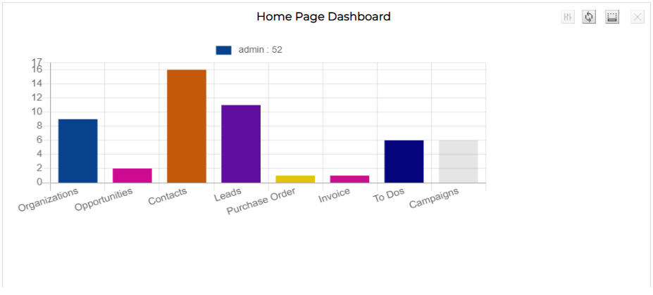
DevBOS
Development Business Operating System, the one stop software solution for your business. DevBOS is a business empowering tool, an adaptable software program that will help your business accomplish it’s goals.

Slide 6
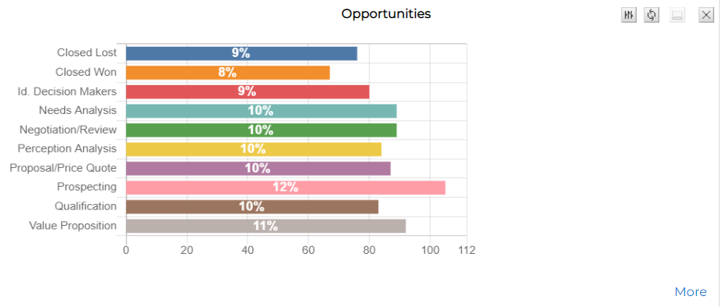
Our Focus
Our mission is to create a framework that will empower the business to help the business owners and the clients.
Tech Stack
HTML
CSS
JS
PHP
Python
Open source Libraries
Phpmyadmin

Slide 7
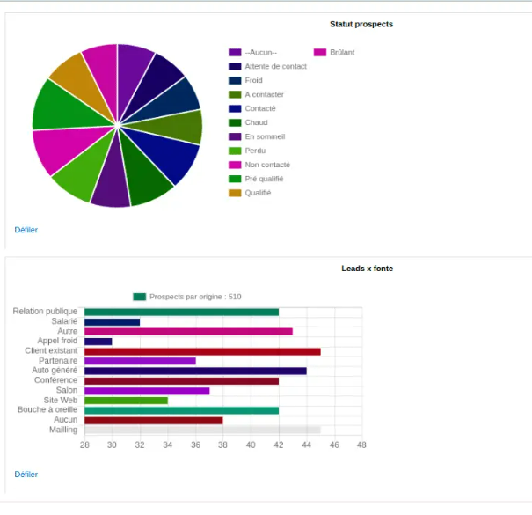
Features that are expected to be done by us
Flexibility and Adaptability:
The real strong point of DevBOS is it’s flexibility and adaptability.
New modules:
Easy to enhance adding new modules.
Workflows:
Easy to adapt and configure using workflows.
New functionality:
Easy to enhance adding new functionality through events and hooks.
Integrate with other systems:
Easy to integrate with other systems through it’s webservice interface.

Slide 8
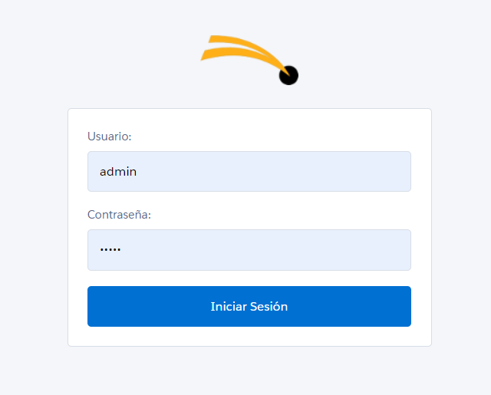
User Interface
The login page was done using php and we are using apache server and sql database.
Every backend data inside devbos was done using php.

Slide 9
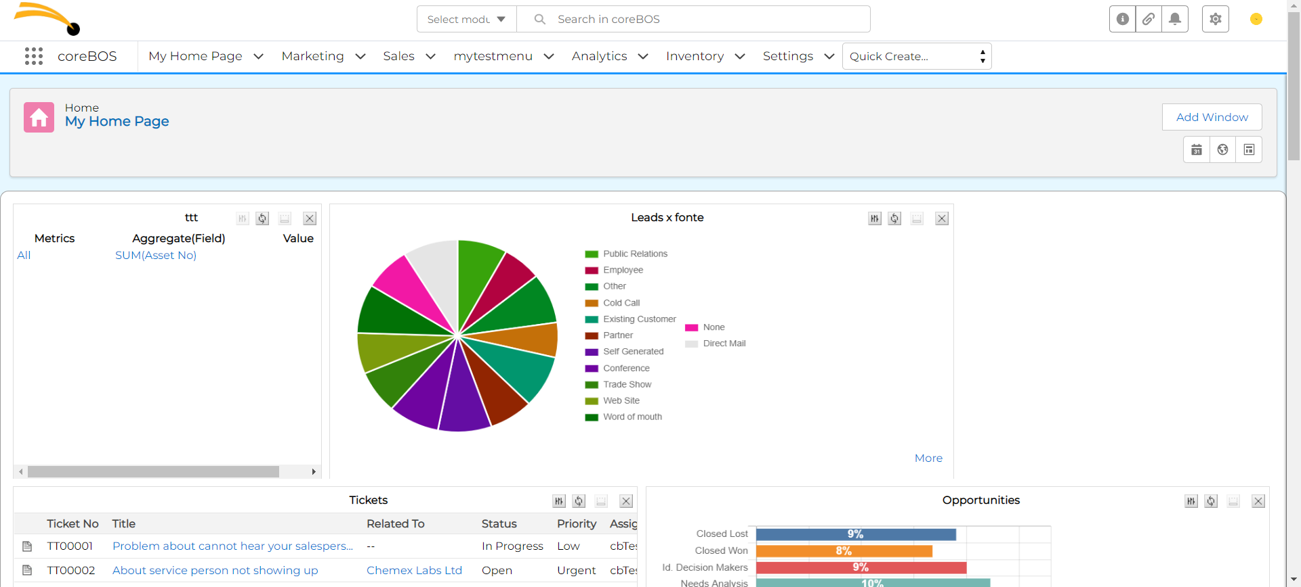
User Interface

Slide 10
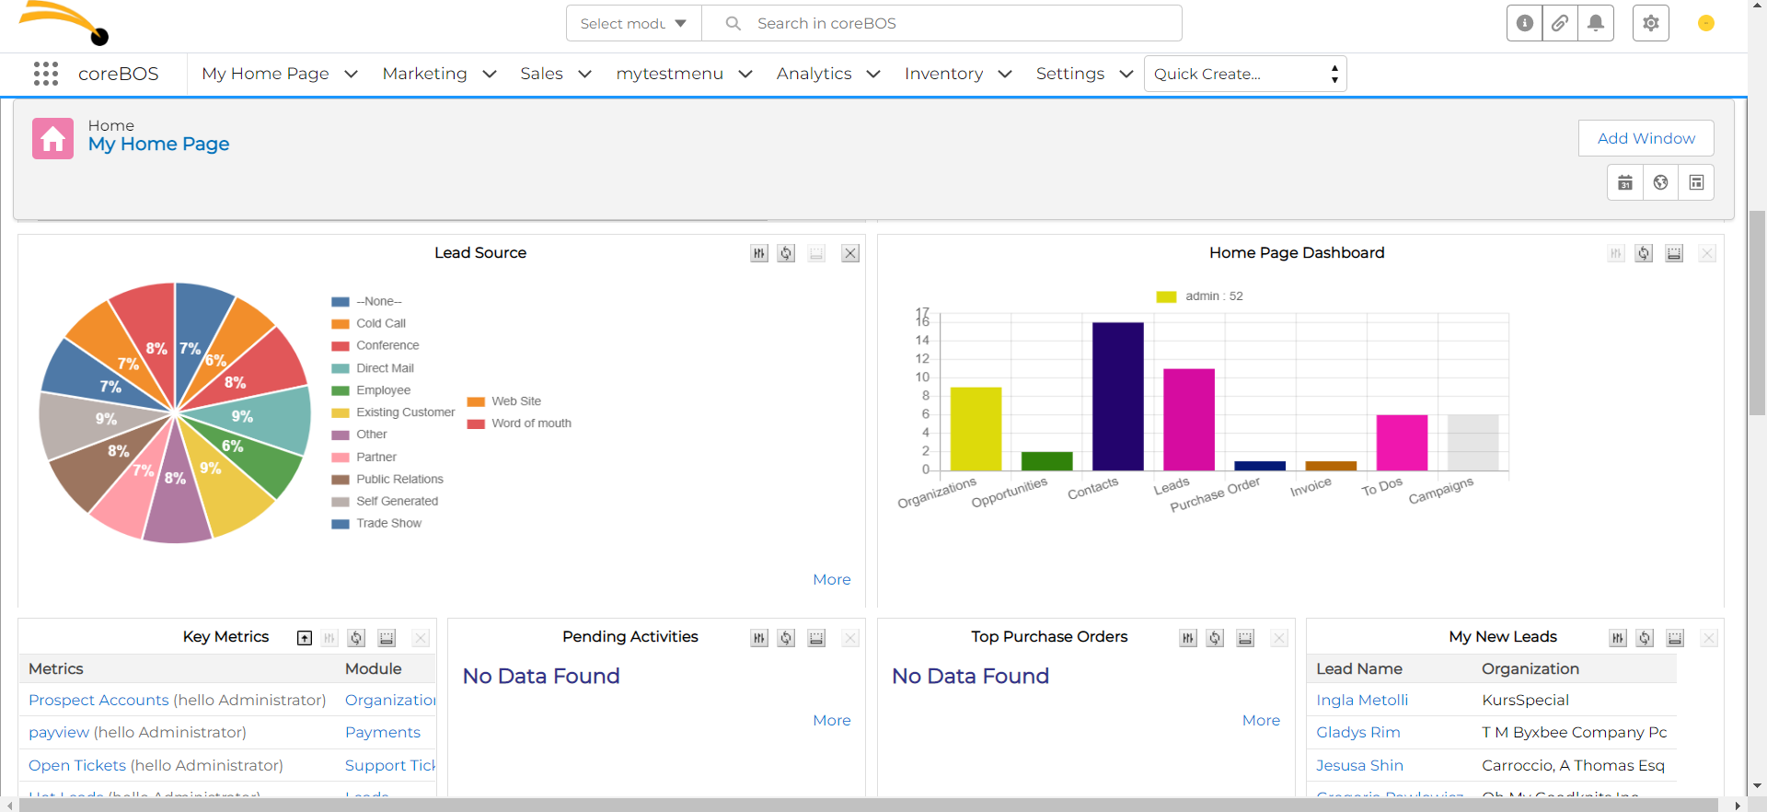
User Interface

Slide 11

Everything was done as expected. Our future mission is to develop this little more.

